Slide 1
Cluster Tracker
Group 4
Ryan Tang Li Yen
Goh Kheng Xi, Jevan
Lock Mei Lin

Slide 2
Content
Aim and outcomes
Mechanical assembly
Operational flow
IWR6843 (mmWave)
L515 (3D camera)
Conclusion

Slide 3
Aim
To enforce social-distancing rules by identifying and tracking clusters of people – cluster size, inter-cluster distance, and inter-cluster interactions – through sensor fusion (radar and LiDAR camera).

Slide 4
Outcome
1. Able to detect and track people from each sensor
2. Able to share data between sensors in real-time for better tracking accuracy
3. Able to measure distances between people and signal for violation
Responsibilities
Ryan Tang : Jetson Nano, mechanical and electronic assemblies
Jevan Goh : mmWave sensor, machine learning algorithms
Mei Lin : LiDAR camera, machine learning algorithms

Slide 5
START
Server (Host PC)
IWR6843
Server main script
Jetson Nano
Read point cloud data
Parsing of data
If new target, send location to Jetson Nano
Request for data (violations from child script)
Servo Control Script
Servo Motor
UART
COMPort
Paramiko
Start servo
Pans L515 to location
L515 child script
END
Human detection
Distance measuring
Check for violation and send back to main script
L515
Visual output
COMPort
Reads RGBD

Slide 6
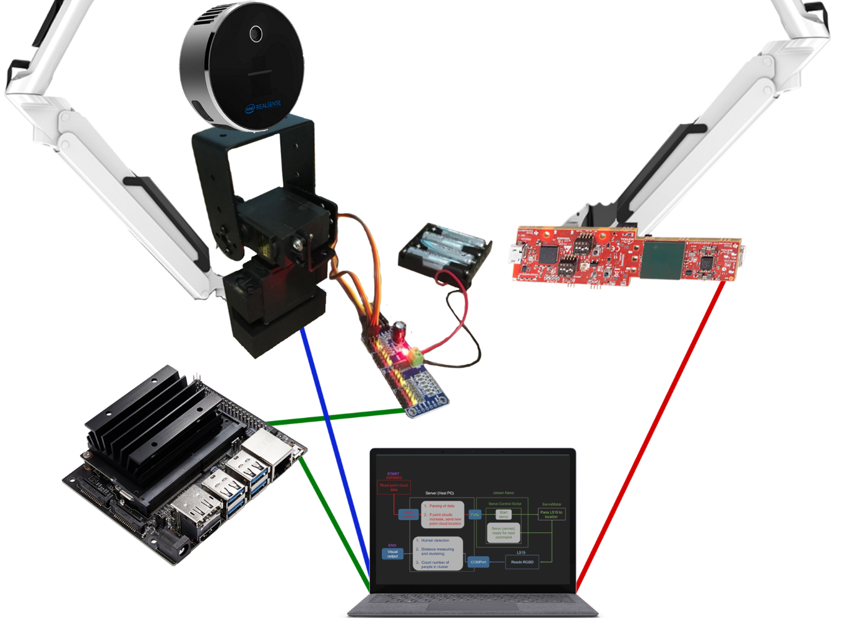
Mechanical Assembly
Power Consumption
Device | Power | Source
Servo Driver | 5 V 4 A | 4 x AA alkaline cells
L515 and mmWave | 5 V 0.5 A | Host PC USB port
Jetson Nano | 5 V 2 A | AC power adaptor
61 mm
Intel RealSense L515 LiDAR Camera
133 mm
23 mm
IWR6843 AOP EVM mmWave Sensor
Pan-tilt servo motors
91 mm
60 mm
PCA9685 PWM/Servo Driver
Jetson Nano
Host PC

Slide 7
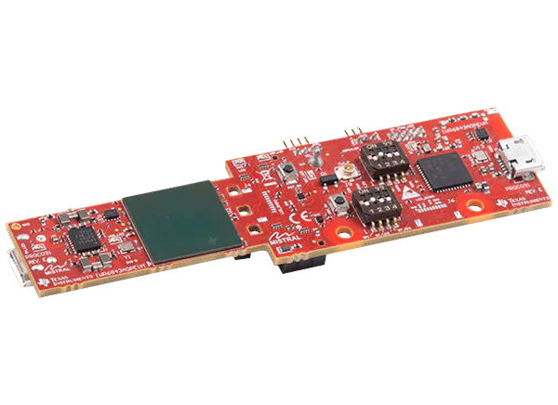
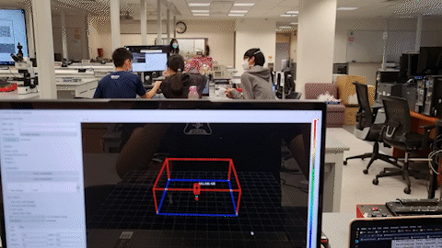
IWR6843 AOP EVM
Fast Modulated Continuous Waveform
60GHz (~4mm)
Range
Velocity and acceleration
Angle

Slide 8
Algorithm (on-chip detection)
Fast-fourier transform
Static clutter removal
Beamforming
CFAR-CASO (Constant False Alarm Rate)
Elevation and doppler estimation

Slide 9
Algorithm (on-chip tracking)
Point clouds tagging
Prediction (Extended Kalman Filter)
Association (DBSCAN - Mahalanobis distance)
Allocate
Update
Maintenance (Detect, Active, Static, Free)

Slide 10
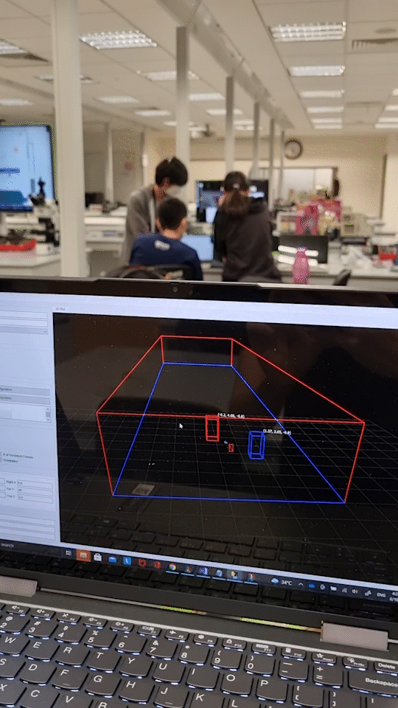

Slide 11
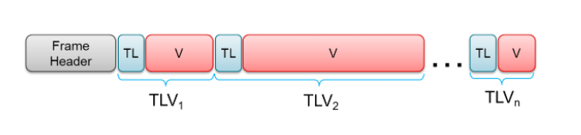
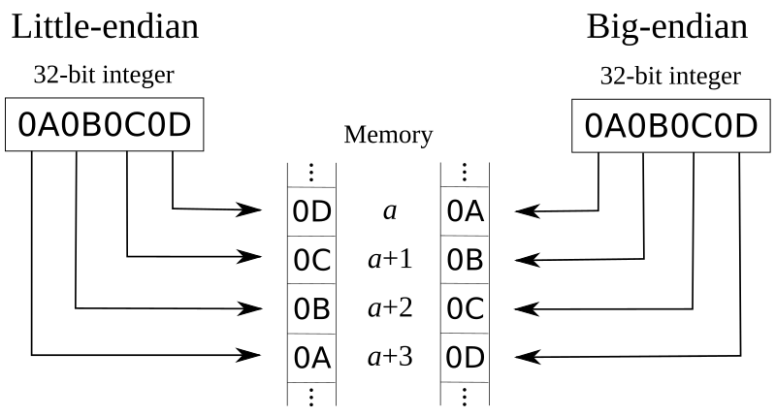
IWR6843 TLV (Server script)

Slide 12
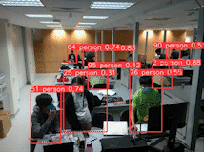
L515
Current state
Able to detect human
Able to count the number of people in a frame
Able to get distance
Able to detect people standing close together

Slide 13
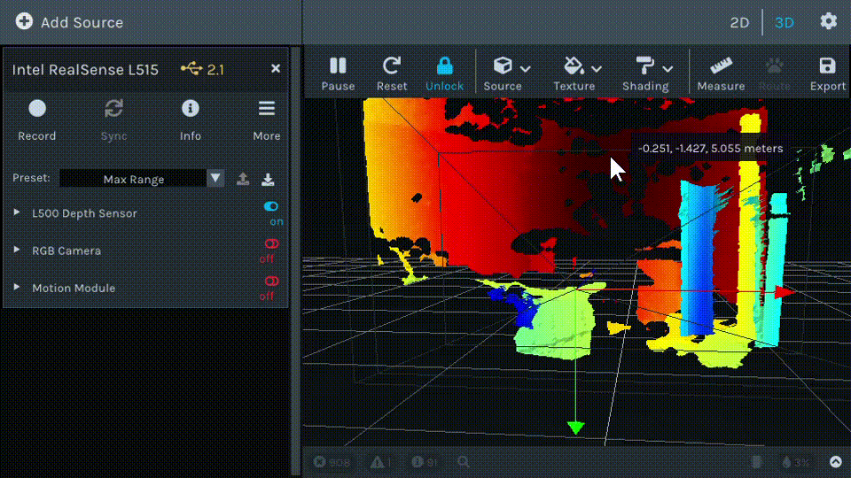
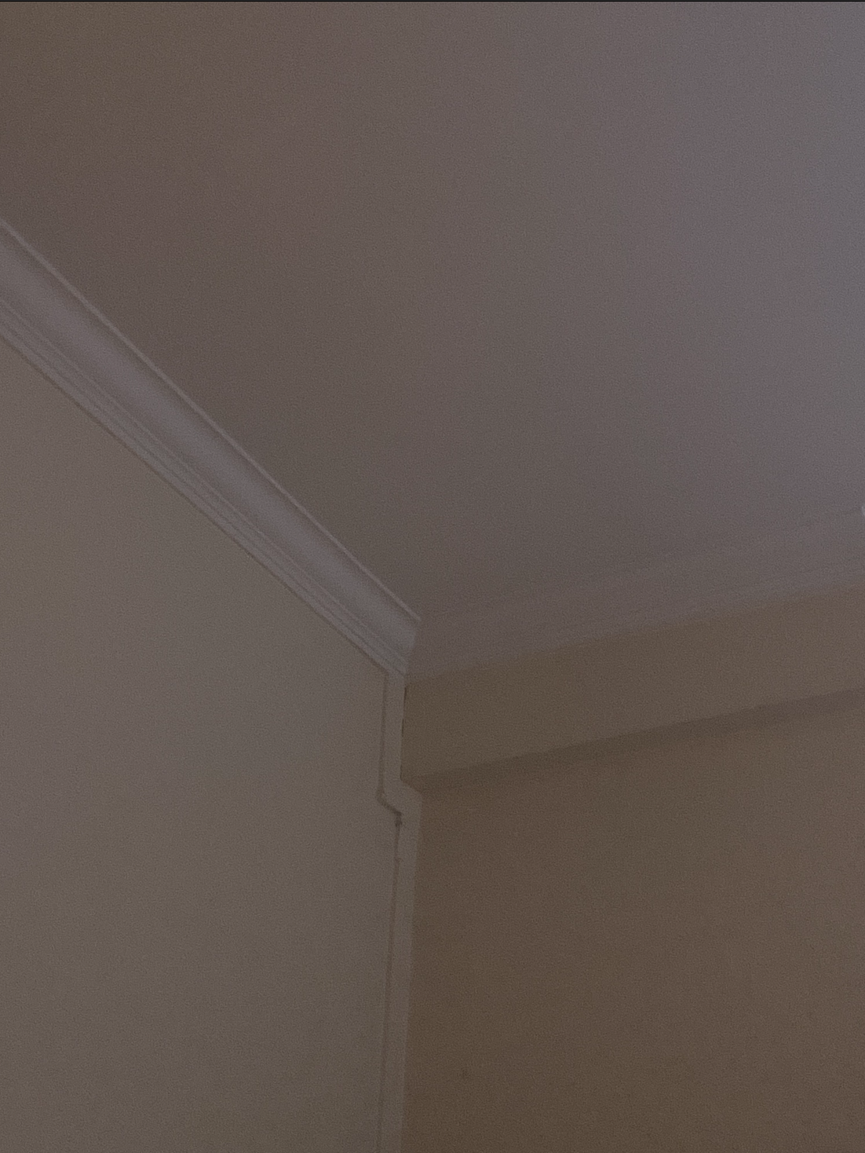
L515 depth data
Time-of-flight depth sensing 3D camera ​
​
Pixels in the depth image represents the distance
Dark red region is the furthest

Slide 14
Object detection model
Locate the presence of human with a bounding box
Pretrained YOLOv5 model to detect the human class
Human detection done on the RGB image
Depth data obtained from the Depth image

Slide 15
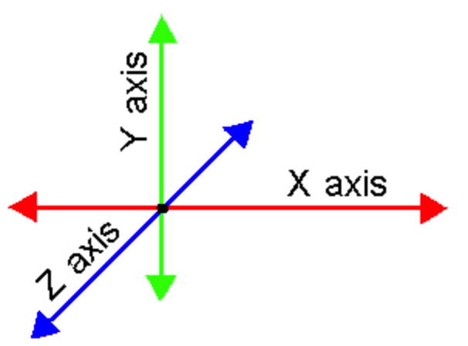
Distance between humans
YOLOv5 returns the 2D pixel coordinates of detected human
Deprojection: 2D pixel coordinates and corresponding depth value mapped to a 3D point location
3D x and z coordinates of the human used to calculate distance
If distance between humans is less than 1.5m, bounding box turns red
Notes:
https://knowledge.autodesk.com/support/maya/learn-explore/caas/CloudHelp/cloudhelp/2015/ENU/Maya/files/Interface-overview-3D-coordinates-htm.html

Slide 16
General specifications
FOV(horizontal) | 120 degrees
Range | 12m
Maximum velocity | 6m/s
Max number of targets | 13
Accuracy | 62%

Slide 17
Thank You!

Slide 18
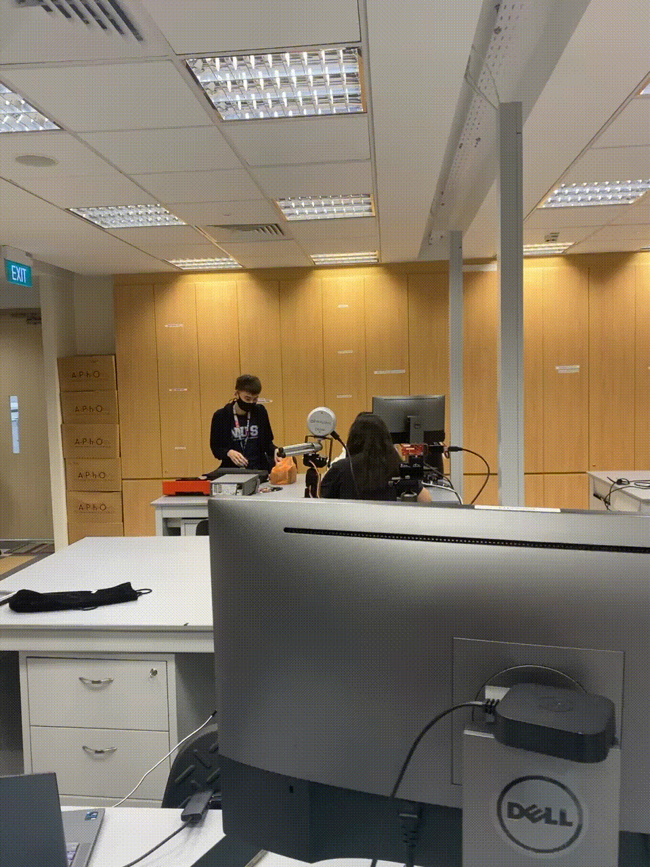

Slide 19
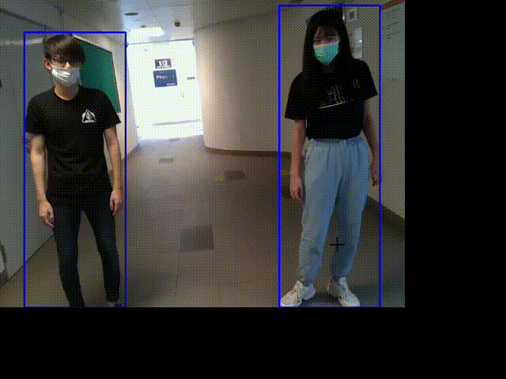

Slide 20
